Slide 1











BY
Pasindu Mahima
Search . . .
NGATOR
LEARNING
SAD PRESENTATIONS
learn.ngator.com

Slide 2




BY
Pasindu Mahima
Search . . .
IMPORTANT POINTS TO REMEMBER
ACTION LISTENERS
JFRAME OPERATIONS
SOFTWARE FINALIZING
JASPER REPORTING
java.awt.event.*
javax.swing.event.*
java.beans.PropertyChangeEvent
GUI
Components
Creating a report
Sub Reporting
EXIT_ON_CLOSE
DO_NOTHING
DISPOSE
Logger
Unit Testing
jar, exe and setup files

Slide 3
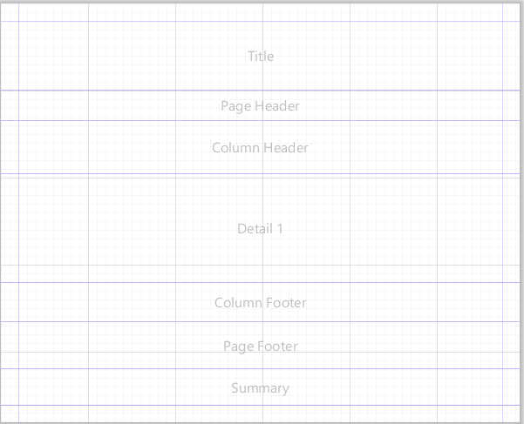
BY
Pasindu Mahima
Search . . .
JASPER REPORTING
GUI
Title
Page Header
Column Header
Detail 1
Column Footer
Page Footer
Summary

Slide 4
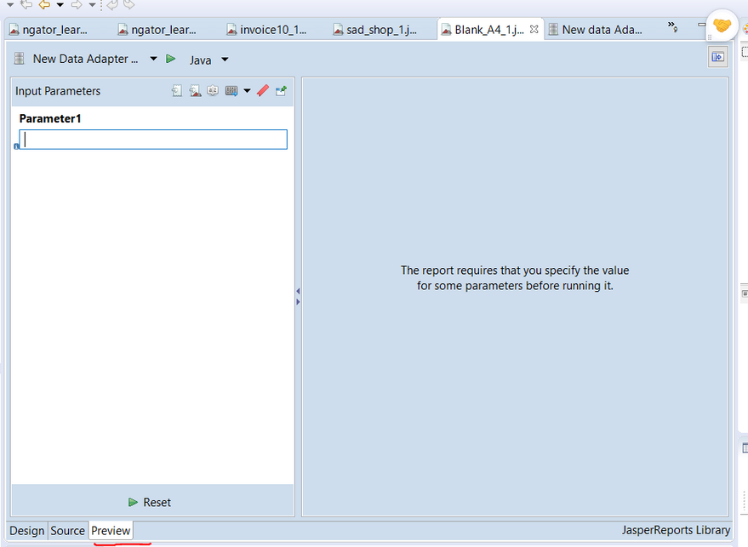
BY
Pasindu Mahima
Search . . .
JASPER REPORTING
Preview View

Slide 5
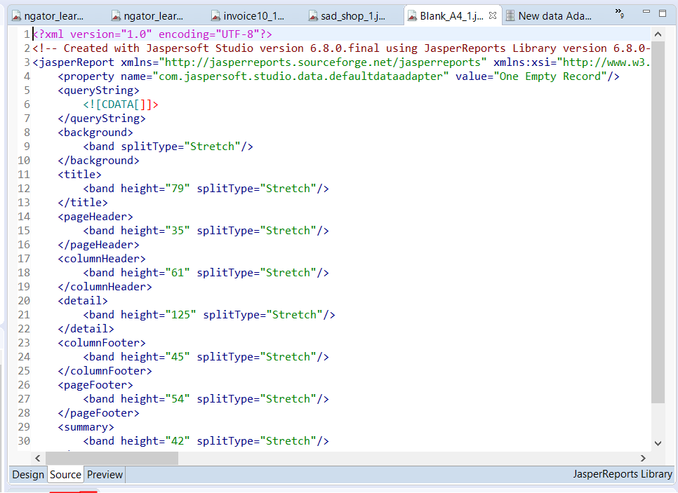
BY
Pasindu Mahima
Search . . .
JASPER REPORTING
Source View

Slide 6
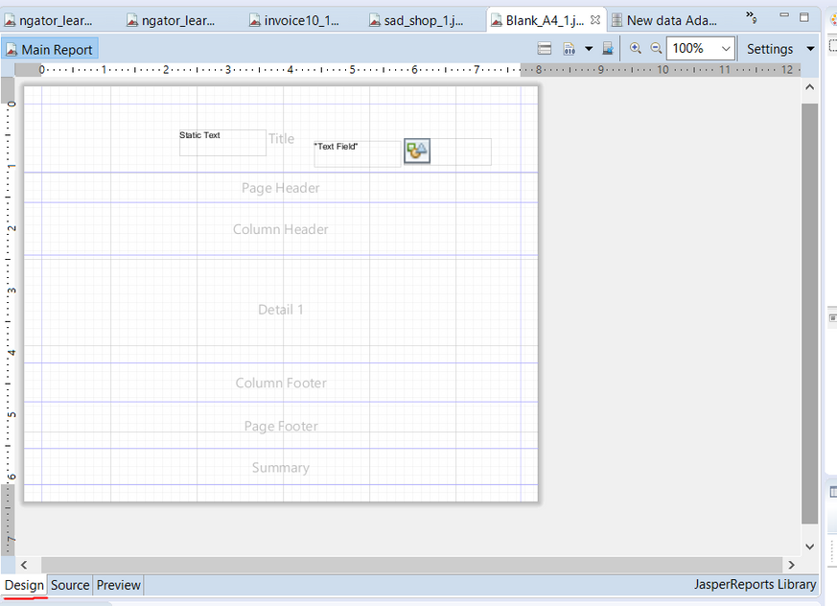
BY
Pasindu Mahima
Search . . .
JASPER REPORTING
Design View

Slide 7
BY
Pasindu Mahima
Search . . .
JASPER REPORTING
Other Components
Basic Components
Parameters
Fields
Static Text
Text Field
Image

Slide 8
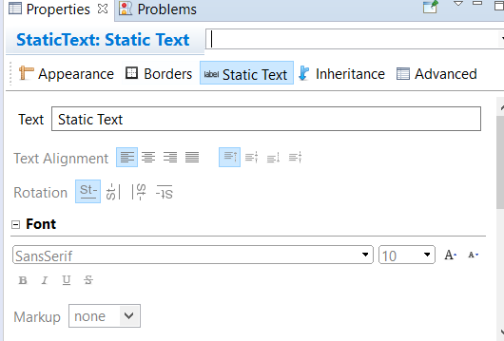
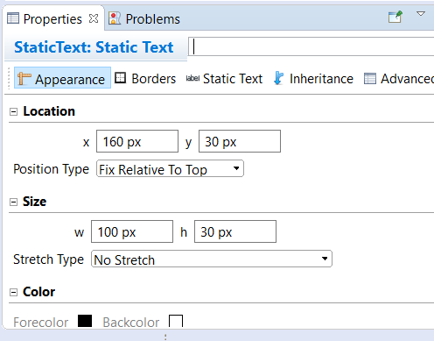
BY
Pasindu Mahima
Search . . .
JASPER REPORTING
Static Text

Slide 9
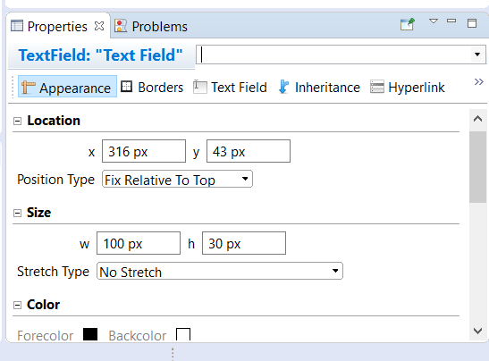
BY
Pasindu Mahima
Search . . .
JASPER REPORTING
Text Field

Slide 10
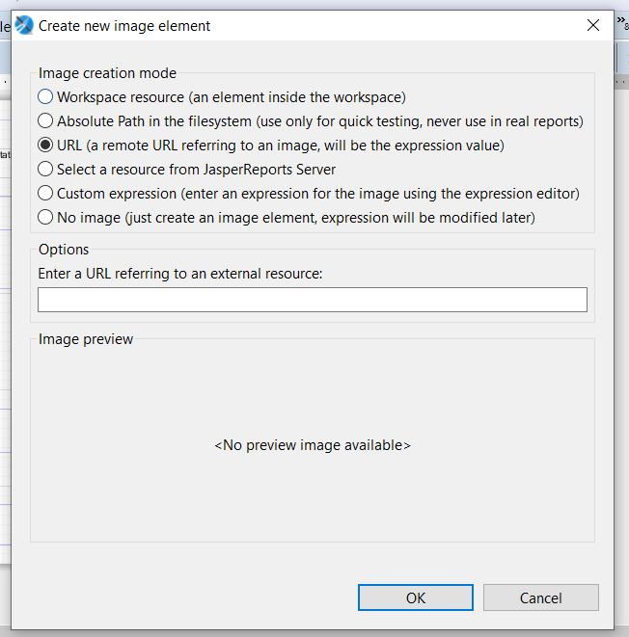
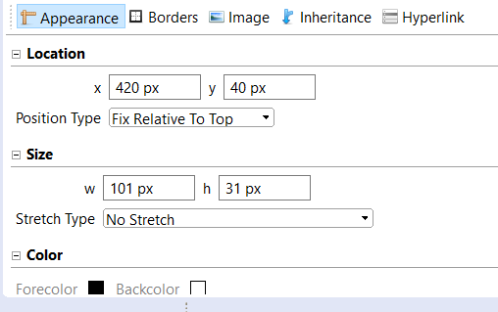
BY
Pasindu Mahima
Search . . .
JASPER REPORTING
Image

Slide 11
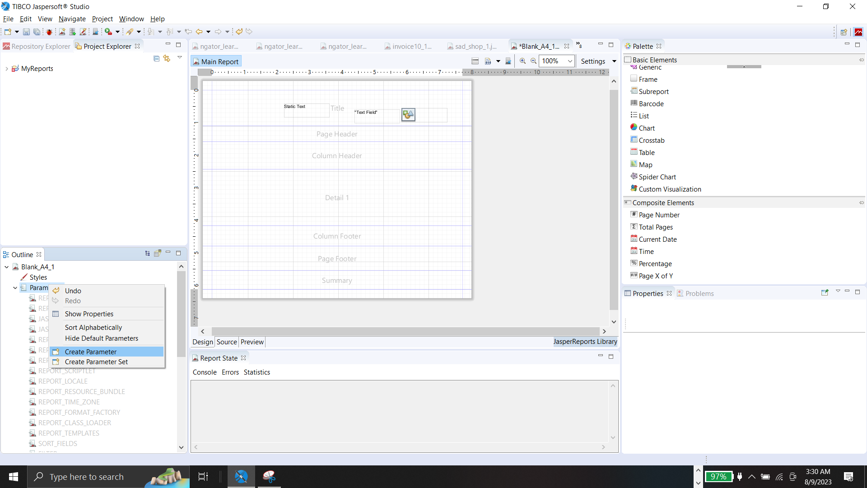
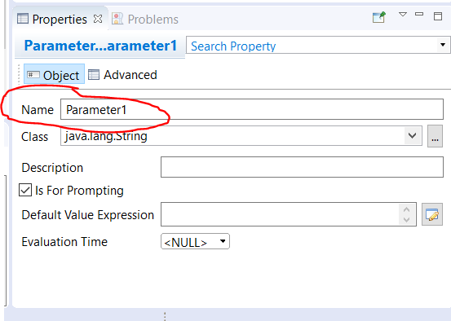
BY
Pasindu Mahima
Search . . .
JASPER REPORTING
Parameter
Change the name of the Parameter

Slide 12
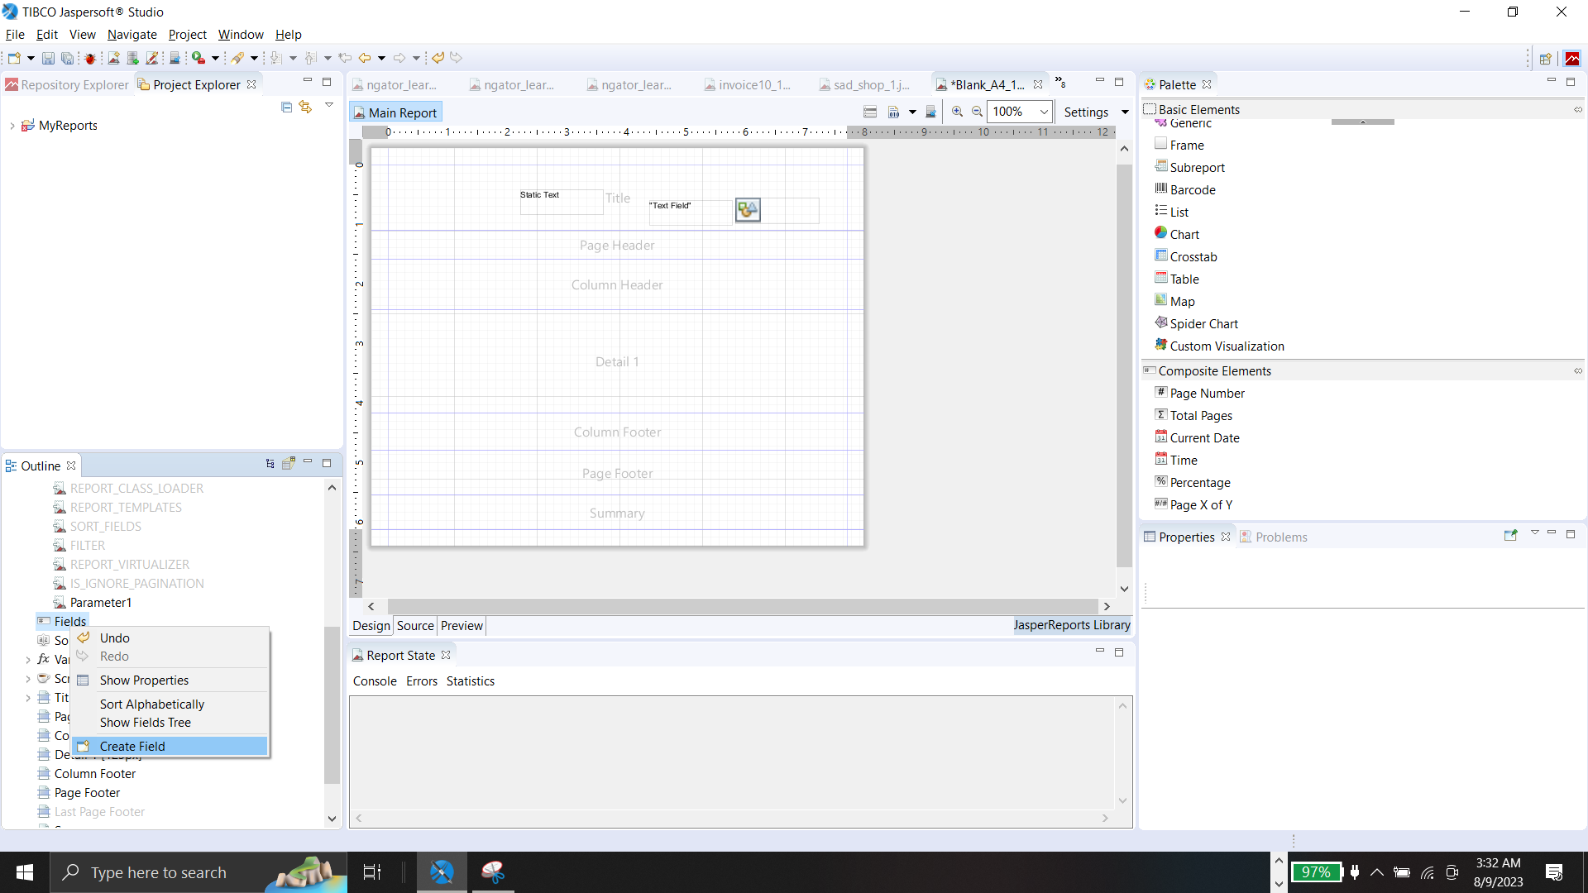
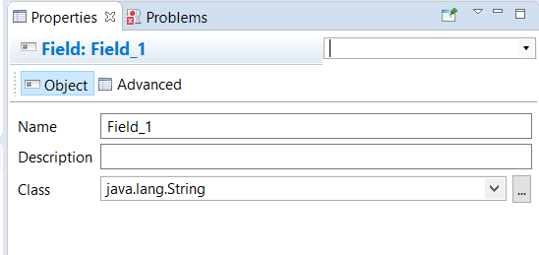
BY
Pasindu Mahima
Search . . .
JASPER REPORTING
Field
Change the name of the Field

Slide 13
BY
Pasindu Mahima
Search . . .
IMPORTANT -
You can't copy and paste both Parameters and Fields.

Slide 14
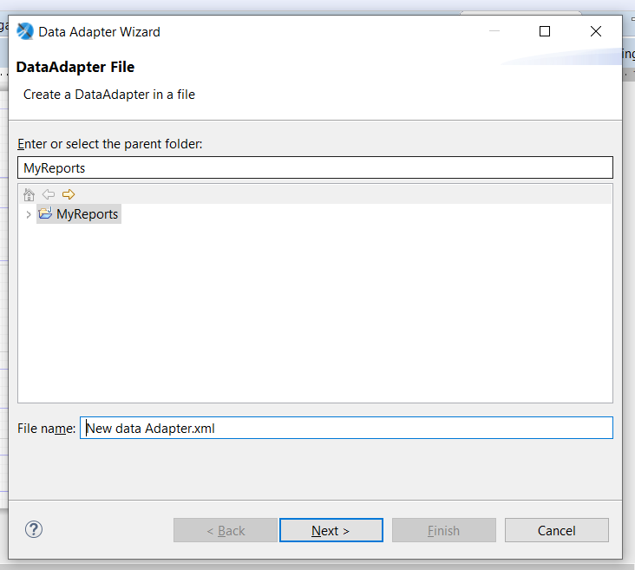
BY
Pasindu Mahima
Search . . .
CREATING A NEW MYSQL DATA ADAPTER
New Data Adapter > Data Adapter Wizard

Slide 15
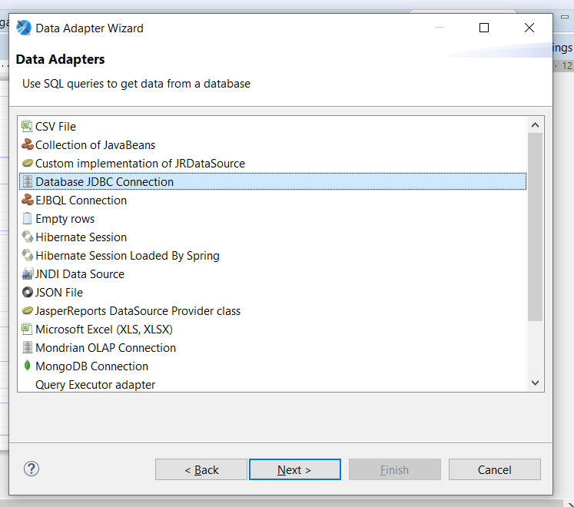
BY
Pasindu Mahima
Search . . .
CREATING A NEW MYSQL DATA ADAPTER
Data Adapter Wizard> Data Adapter > Database JDBC Connection

Slide 16
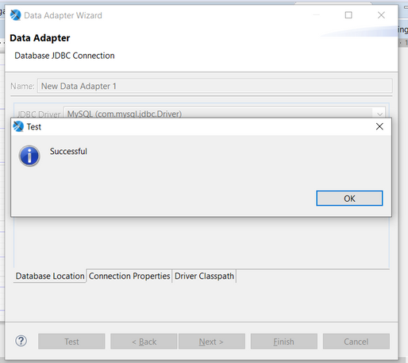
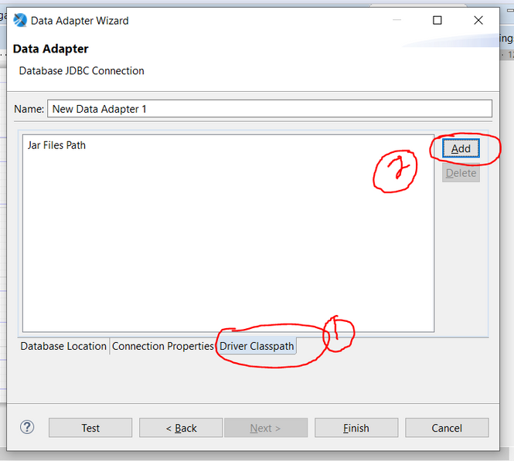
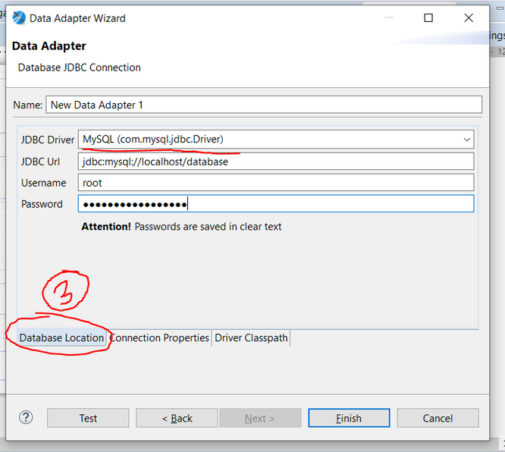
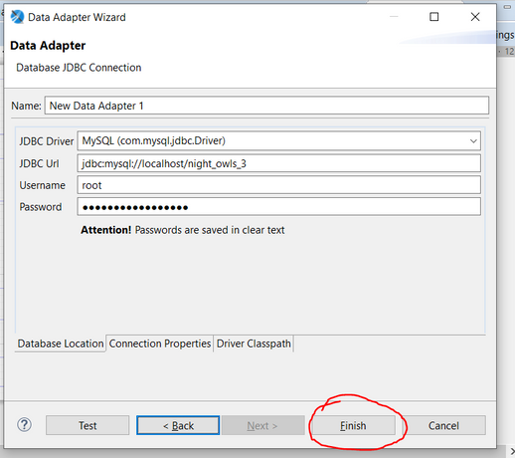
BY
Pasindu Mahima
Search . . .
CREATING A NEW MYSQL DATA ADAPTER
Data Adapter Wizard > Data Adapter >
Select the JDBC Connection

Slide 17
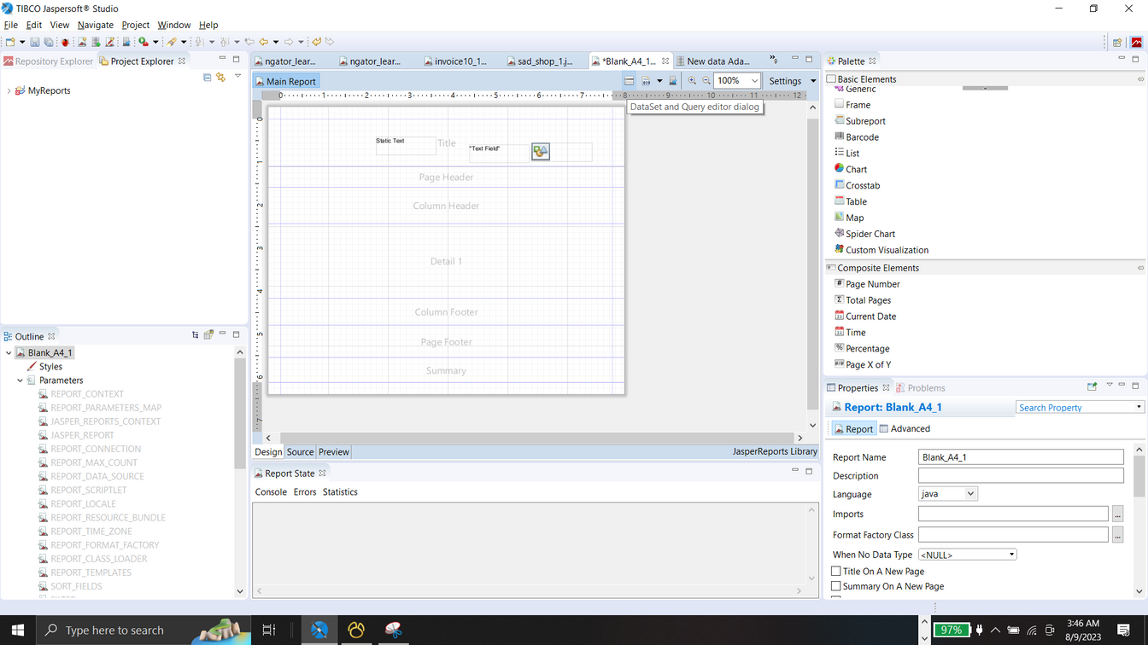
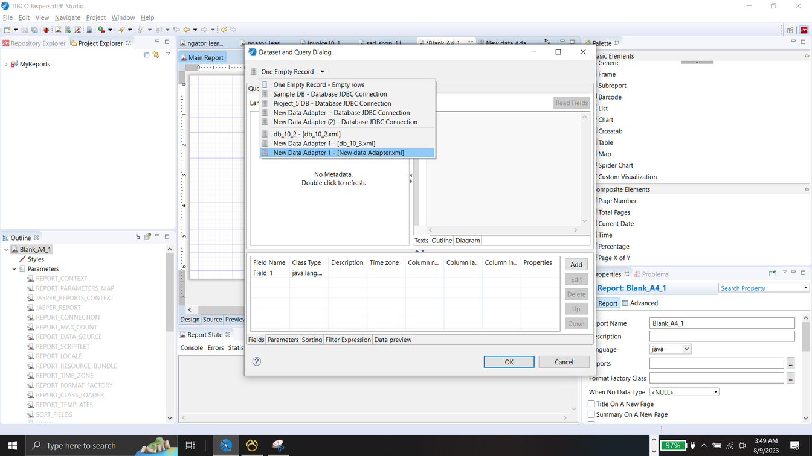
BY
Pasindu Mahima
Search . . .
SETTING UP THE NEW MYSQL DATA ADAPTER
DataSet and Query Editor Log

Slide 18
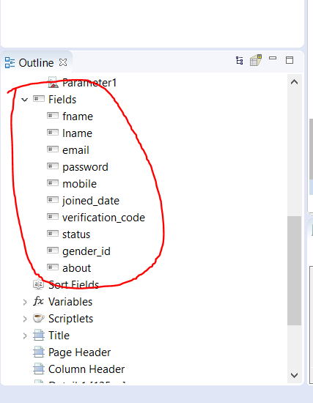
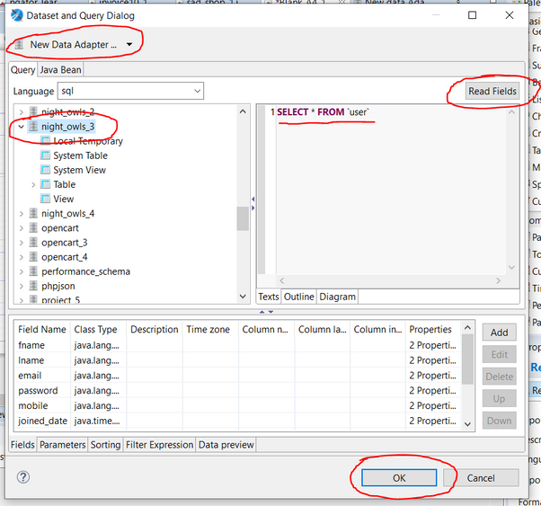
BY
Pasindu Mahima
Search . . .
SETTING UP THE NEW MYSQL DATA ADAPTER
If finished successfully
DataSet and Query Editor

Slide 19
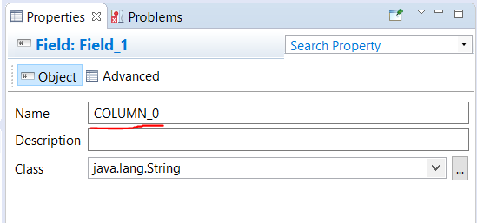
BY
Pasindu Mahima
Search . . .
RENAMING THE COLUMNS TO SETUP JTABLE DATA
COLUMN_0 - First Column
COLUMN_1 - Second Column
COLUMN_2 - Third Column

Slide 20
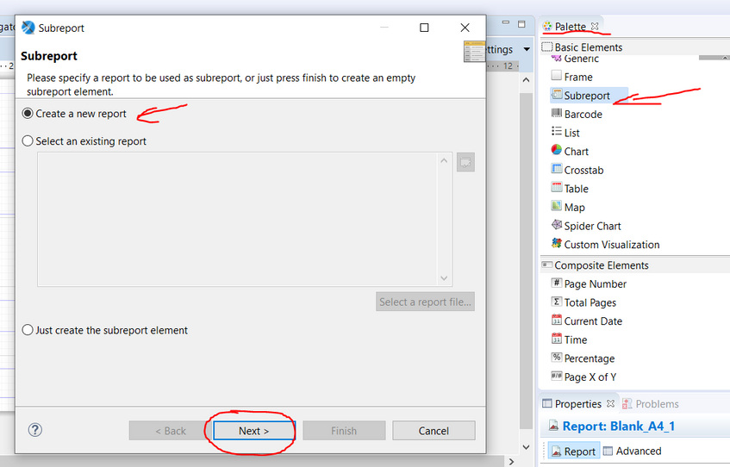
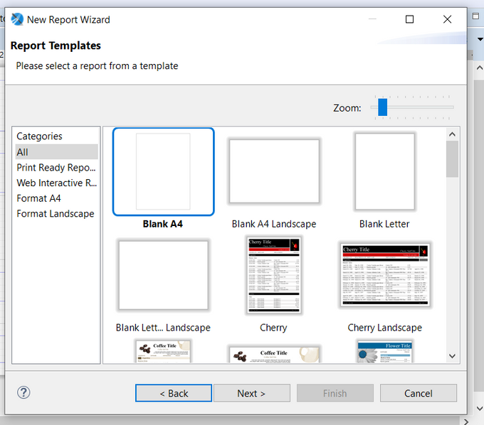
BY
Pasindu Mahima
Search . . .
SUB REPORTING

Slide 21
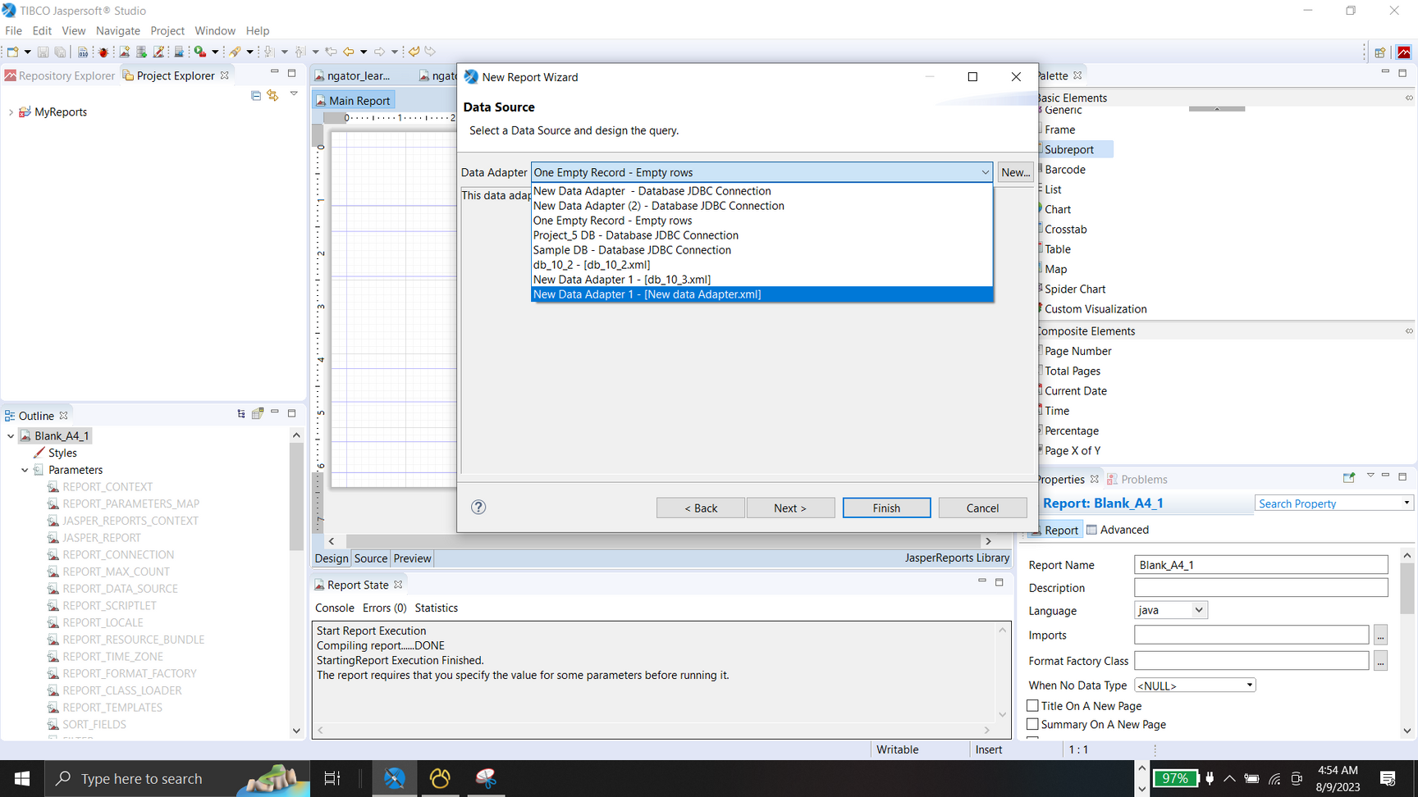
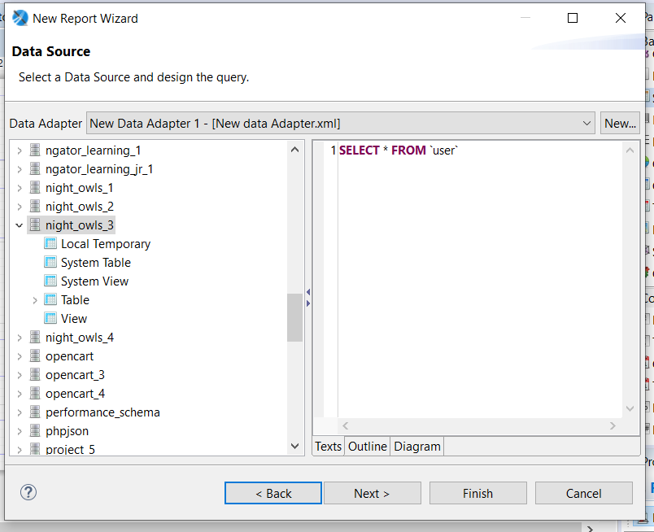
BY
Pasindu Mahima
Search . . .
SUB REPORTING
Sub Report Wizard

Slide 22
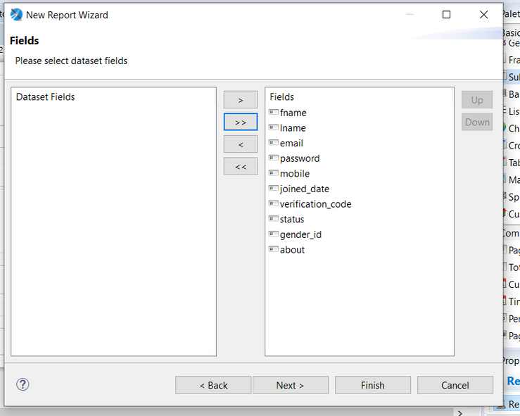
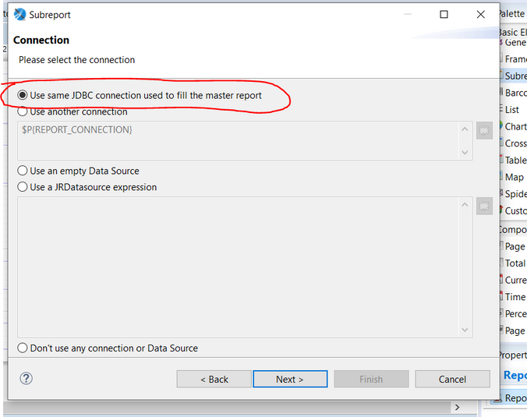
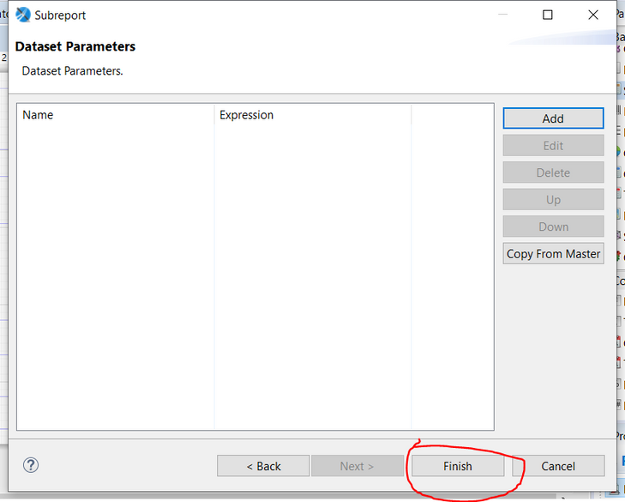
BY
Pasindu Mahima
Search . . .
SUB REPORTING
Sub Report Wizard

Slide 23
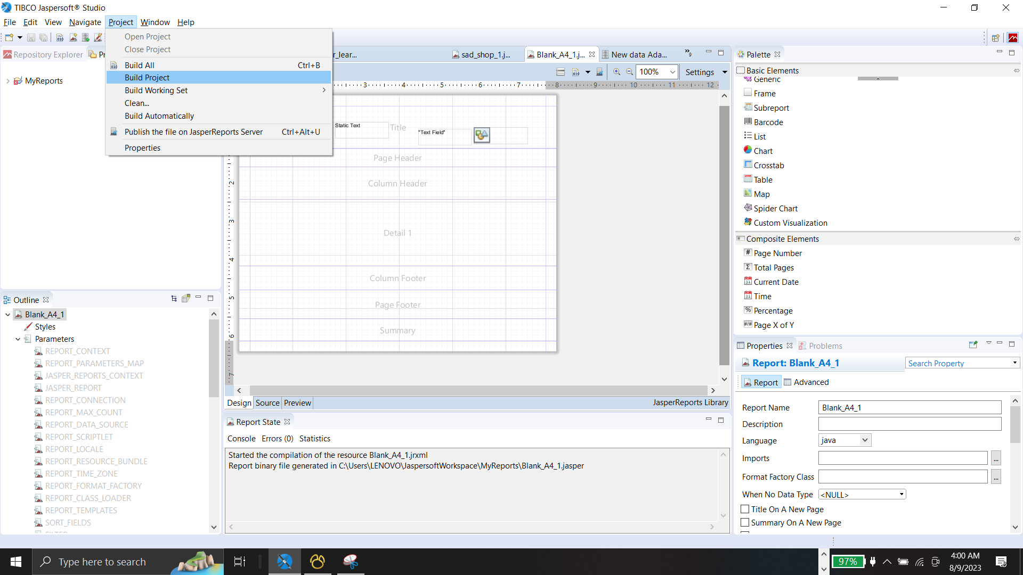
BY
Pasindu Mahima
Search . . .
BUILDING THE PROJECT
Project > Build Project

Slide 24
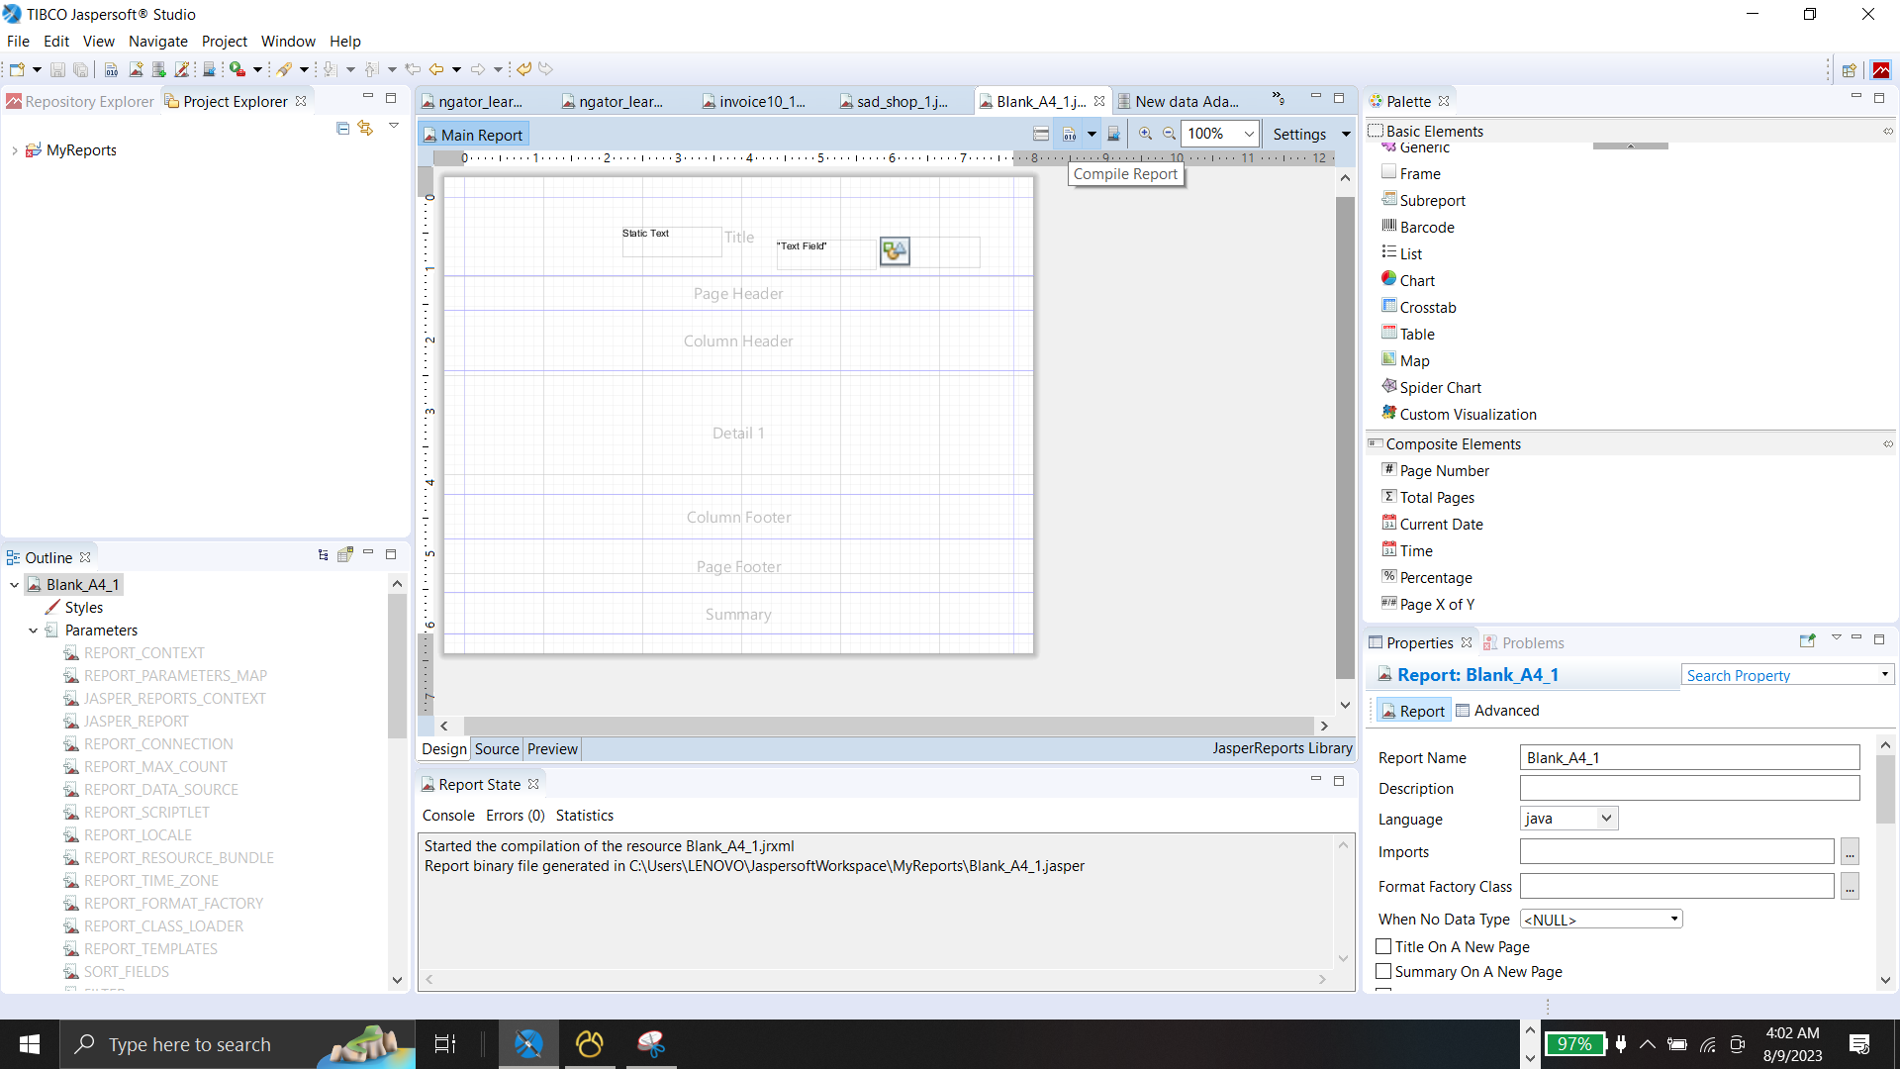
BY
Pasindu Mahima
Search . . .
COMPILING THE PROJECT
Compile Report

Slide 25

BY
Pasindu Mahima
Search . . .
THANK YOU
Social Profiles
Follow Ngator on social networks
Facebook : https://www.facebook.com/learnwithngator
Instagram :https://www.instagram.com/mahimapasindu/
GitHub : https://github.com/drgnhunter
LinkedIn : https://www.linkedin.com/in/pasindu-mahima-3a0031187/
END SLIDE

